Slide 1
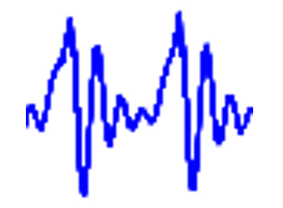

Distributed Streaming Processing:
Implementation of LPC for Signal Processing using Flink
DBPRO - WS 19/20 Final Milestone
Lyubomira Gerova
Yordan Grigorov
Ardeshir Soltani Nejad

Slide 2
Agenda
Intro Introduction to EmoDB Changes since last time Simple Emotion Detection with Mean Value in Pandas Introduction to Grafana Coupling Flink-Influx and Influx-Grafana Visualization with Grafana

Slide 3
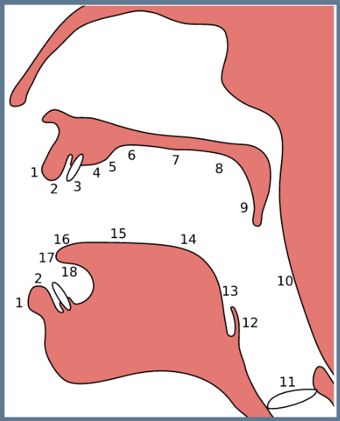
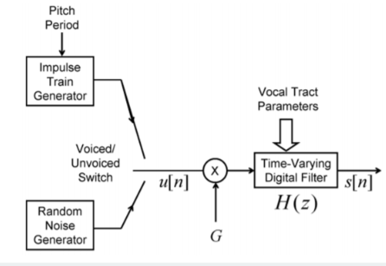
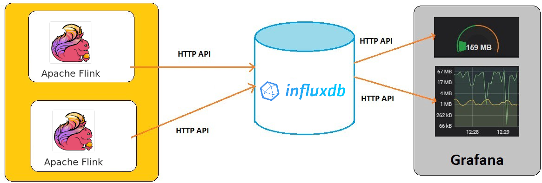
Introduction - so far
Human Speech as math. model
Signal Processing
Streaming with Apache Flink
Emotion
Visualization
Notes:
First, I’ll help you to recollect what we’ve done so far.
In previous presentations we’ve shown you how humans produce speech and how we can model this mathematically.
To do so, we had to delve into Signal Processing, Stream Windowing, filtering and detecting correlation in signals.
Last time we had a fully functional LPC implementation in Java using Apache Flink as a stream processing platform.
Today we’ll show you how we have further developed the project using recordings that express emotion.

Slide 4
Introduction to EmoDB: TU Berlin 1997-1999
535 sentences. Stanislavski Method
Perception test
7 emotions:
Anger (Wut)
Boredom (Langeweile)
Disgust (Ekel)
Anxiety/Fear (Angst)
Happiness (Freude)
Sadness (Trauer) Neutral
Read database
Correlation?
Notes:
EmoDB is a database of emotional sentences, recorded in the TU Berlin.
The database consists of about 500 short sentences, recorded using the Stanislavski method. This is a method that actors use to achieve realistic emotion. 5 male, 5 female actors
<<80% recognized, 60% natural>> The recordings that made it in the final database had to pass a perception test, in which the emotion had to be recognized by at least 80% of the listeners and at least 60% must have perceived it as natural, e.g. not over/underplayed.
Our goal for today’s milestone was to read the database in bulk using our program,
and see if we can spot some correlation between the coefficients we calculate and the emotion of the sentence.

Slide 5

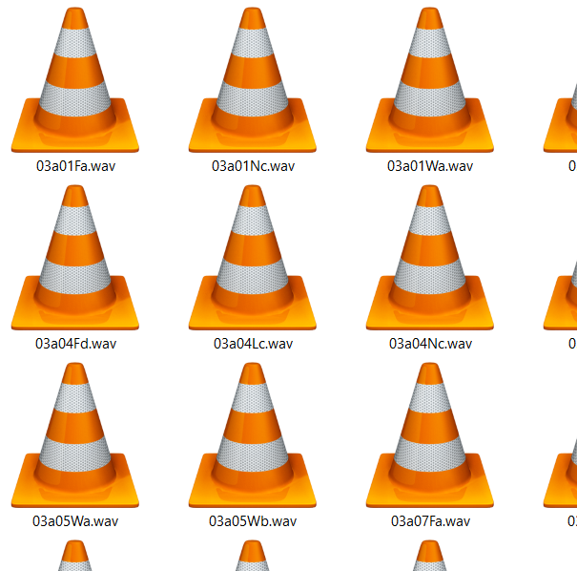

Changes since last time
import CSV
<actor>,<sentence>,<emo>,..,<alpha>
<actor>,<sentence>,<emo>,..,<alpha>
<actor>,<sentence>,<emo>,..,<alpha>
...
Notes:
First, we had to adjust our program to better handle the processing of multiple files. If you remember from last time, for a single file, we created 5 separate text files.
Since, we didn’t need all of those files to analyze emotions, we narrowed down our input to only the alpha coefficients.
Then we decided it was easier to output all the coefficients from all audio files in a single text file.
That way, we could easily import the CSV file into any data analysis toolkit and spot correlations in the data.
Each line in the file contains all available data for the file, for example actor, type of sentence etc. and importantly, the actual emotion of speech.

Slide 6


Simple Emotion Detection with Mean Value in Pandas
mean_a minAlpha maxAlpha
emotion
T 0.0745 -inf 0.1049
L 0.1354 0.1049 0.1371
N 0.1388 0.1371 0.2023
A 0.2659 0.2023 0.2701
E 0.2743 0.2701 0.3301
F 0.3860 0.3301 0.4190
W 0.4520 0.4190 inf
Learn
Data
Matches 35% of the time. ~ 2.5x better than random guess
Test
Notes:
To prove a correlation exists between the alpha coefficients and the emotion, we needed a simple, “batteries included” way to do the calculations. We chose Python, using the Pandas data analysis tool.
We used a very simple approach:
1)We did a random 80 to 20 split to obtain a learn-, and test dataset.
2)<click> We calculated the mean value for each emotion, no matter the gender of the speaker, or type of sentence.
3)From there, we calculated some upper and lower boundaries to visualize roughly where the mean coefficients of each emotion lie.
4)Using those boundaries as a classifier, we were able to predict our test dataset correctly 35 percent of the time. That’s nothing impressive, but it’s 2.5 times better than randomly guessing.

Slide 7
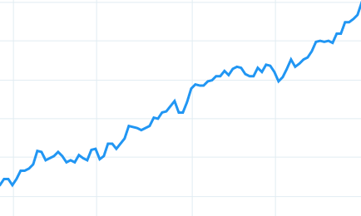

Further improvements for emotion detection
Pattern Direction
Language difference
More Variables
<actor>
<gender>
<age>
<sentence type>
Notes:
We also have some ideas how this can be improved:
1)First, we can take into account the information we’ve been ignoring, such as gender of speaker and type of sentence.
2)Maybe the beginning, the middle or the end of a sentence give more information about its emotion. Different patterns could be tested using weighted average instead of a simple average.
3)Perhaps the direction of the coefficients (falling, rising, arching) also play a role.
4)x Probably all of those ideas and more could be integrated into a complex algorithm
5)Further improvements should also take a look at the database used. Developing a good algorithm, only to be learned and tested on 500 sentences is excessive.
For example, I was able to find a 10 times bigger emotional database, created at the University of Toronto, but then we should ask the question: does it matter that it’s in a different language?

Slide 8
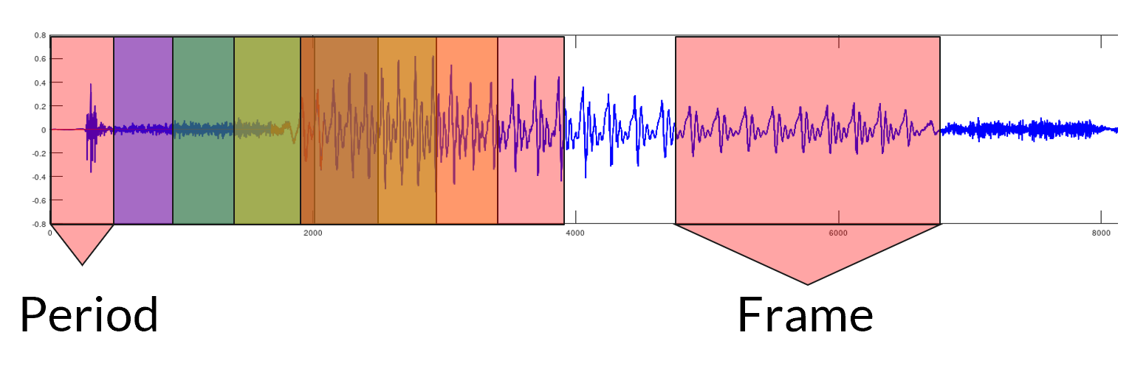
Tumbling & Sliding Windows
Notes:
Dieses slide ist hoffentlich euch vom letzten mal bekannt wo wir über windowing konzept besprochen hatten.

Slide 9
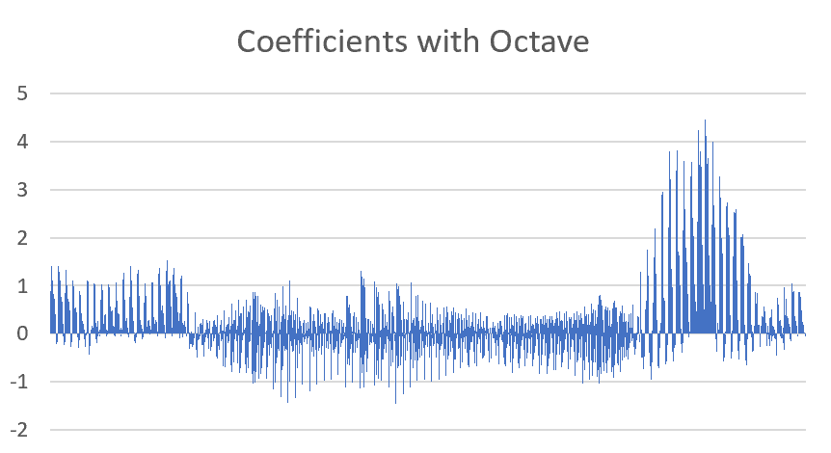
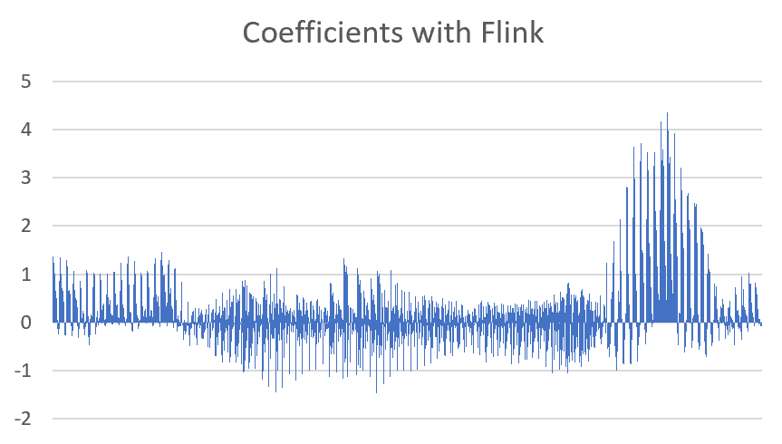
Octave vs. Flink
For the same audio file named “curious” we achieved same outputs
The original 16000 samples reduced into 2100 ones (105 windows, 20 coefficients per window)
Notes:
Wir können das als ein vergleich bzw. Beweis nutzen sicher zu stellen dass unsere Ergebnisse soweit mit dem Algorithmus übereinstimmen.
Das habe ich mit Excel erstellt.
Aber wenn wir der Graph an sich untersuchen wollen wird etwa schwierig weil relative viele Schwankungen zu sehen sind.
Deshalb kommen wir auf die Idee den Graph noch einfacher hinzukriegen.
Wie wäre es wenn wir unserer Graph noch mehr verfeinern und zwar …
An dieser Stelle die X Achse ist einfach von 1 bis 2100 durchnummeriert aber in der Realität time-domain kommt in Frage.
Deshalb brauchen wir eine Zeitbasierte Datenbank.

Slide 10

InfluxDB
an open-source time series database
provides a SQL-like language
has no external dependencies
Query Example:
select * from “sensors”
Name: curious
time key value
- - - - - - - - - - -
1575414000520000000 a 0.8736125807679866
1575414050520000000 a 0.8697569228483913
Notes:
Influx ist keine relationale Datenbank. Das heißt, es gibt kein tables wie in mySQL. Influxdb arbeitet mit data points. Ein data point ist eine Messung zu einem bestimmten Zeitpunkt, also einen Tupel. Points sind in series gruppiert und mehrere series bilden einen measurement. InfluxDB hat eine eigene query language, die sehr ähnlich zu SQL ist. Die Datenbank ist eine kleine ausführbare datei und sie ist sehr leicht einzurichten, es gibt keine dependencies.

Slide 11
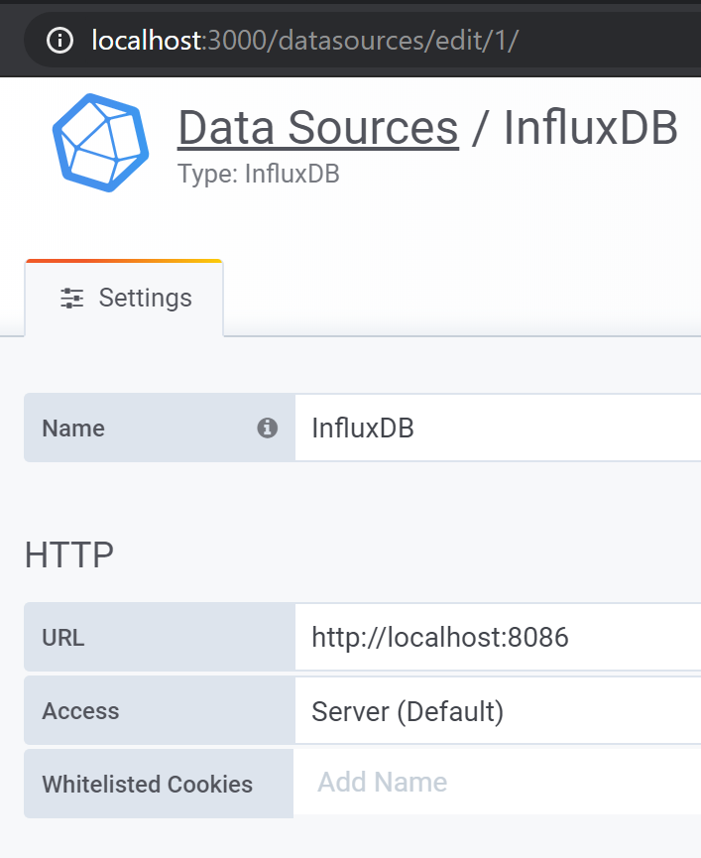
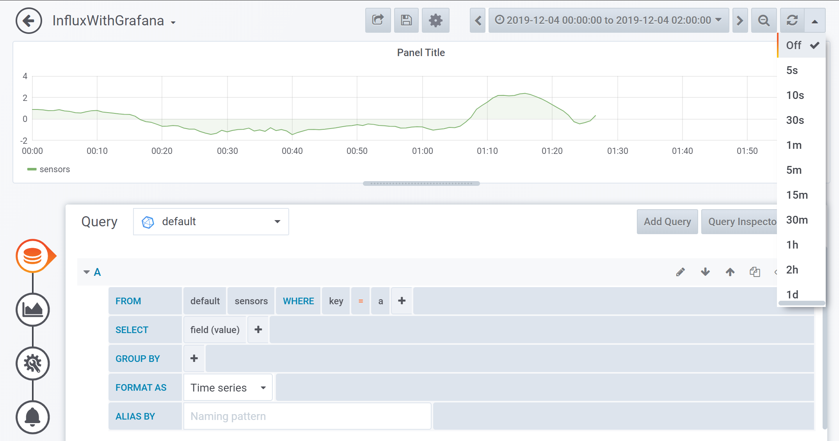
Grafana
Notes:
Grafana ist ein leistungsstarkes open-source Tool zur Visualisierung von Daten. Das hier ist ein Beispiel für einen Dashboard. Ein Dashboard besteht aus mehrere Panels. Grafana kann Daten aus mehreren Quellen simultan bekommen und alles auf verschiedene Weise darstellen. Unser Dashboard ist aber nicht so kompliziert wie diese, ich zeige euch gleich:

Slide 12
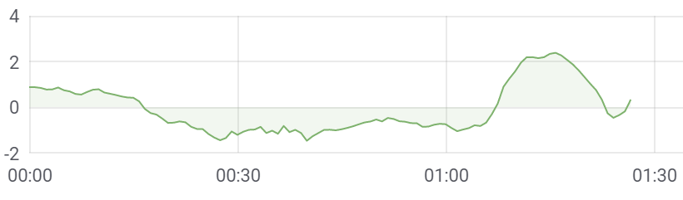
Visualization
The computed 2100 (105 windows, 20 coefficients per window) sample reduced into 105 ones
Just the first coefficient per window

Slide 13



Angst vs. Langweile
Aussage: Heute Abend könnte ich es ihm sagen.

Slide 14
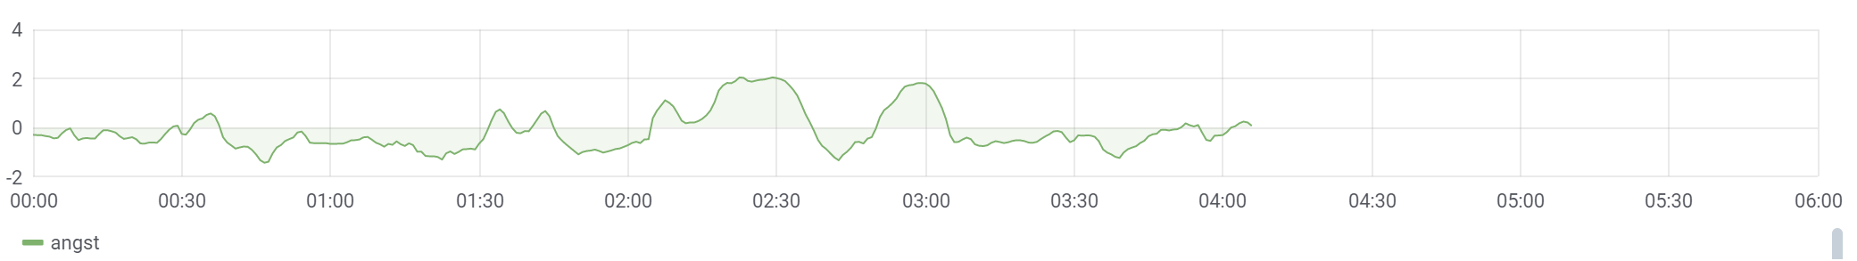
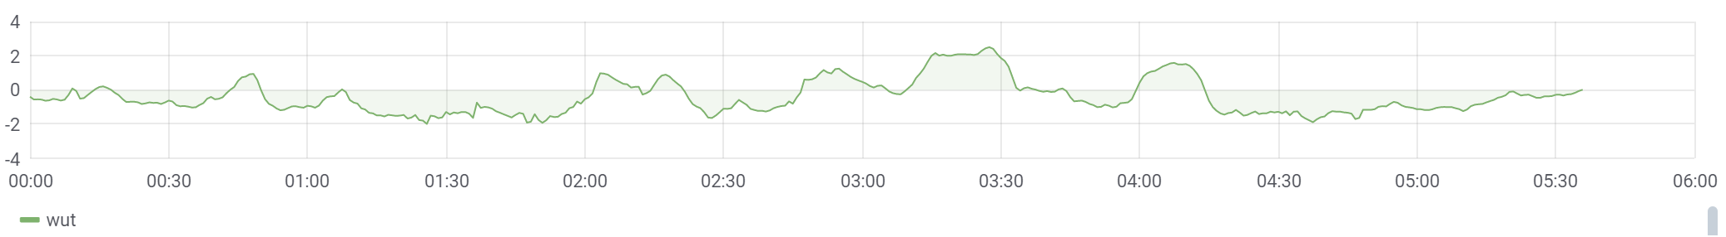
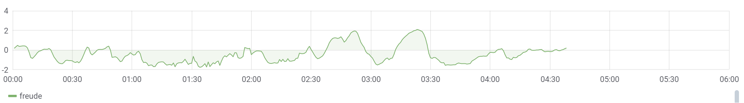
Angst - Wut - Freude
Notes:
Sind 3 Emotionen in dem man normalerweise lauter redet. Der Wertebereich von Y-Akse wird maximal bzw. Erreicht -4 und +4. Diese Wertebereich wird automatisch von Grafana skaliert sobald die Daten eingespielt werden.

Slide 15
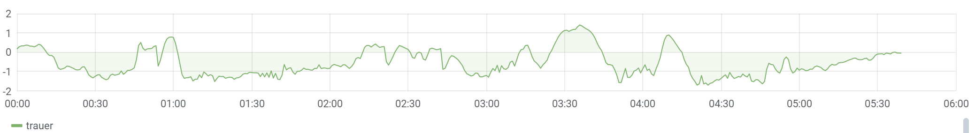
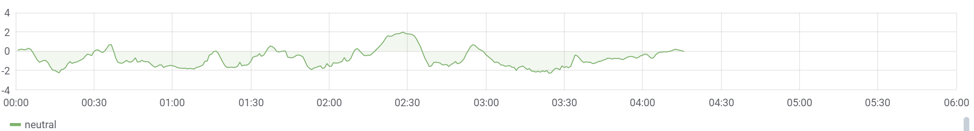
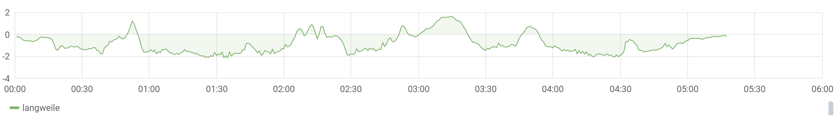
Trauer - Neutral - Langweile
Notes:
Der wertebereich von neutral ist wegen nur ein Ausreißer passiert. Sonst kann man sagen dass die Maximale Zahl liegt bis 2.

Slide 16






Mean Comparison

Slide 17
Thank you for your attention
Q & A

Slide 18
https://www.google.com/imgres?imgurl=https%3A%2F%2Fwww.mueller-frahling.de%2Fwp-content%2Fuploads%2F2016%2F01%2Fmuellerfrahling-016-p1.jpg&imgrefurl=https%3A%2F%2Fwww.mueller-frahling.de%2Fangst-substanz-staerken-mit-nr-2%2F&tbnid=zaoCsZqWUSoFpM&vet=12ahUKEwii3on40L_nAhUDEhoKHXDgAQYQMygHegUIARDnAQ..i&docid=8_tPEP2h3s-ehM&w=848&h=444&q=angst%20fotos&ved=2ahUKEwii3on40L_nAhUDEhoKHXDgAQYQMygHegUIARDnAQ
https://www.google.com/url?sa=i&url=http%3A%2F%2Fwww.eichhorn-office-solutions.de%2Fratgeber%2Flangeweile-im-buero-das-virus-ohne-fieber%2F&psig=AOvVaw0o8Ox1D7rBmxShAR2wg953&ust=1581171772764000&source=images&cd=vfe&ved=0CAIQjRxqFwoTCODZoNHSv-cCFQAAAAAdAAAAABAi

Slide 19
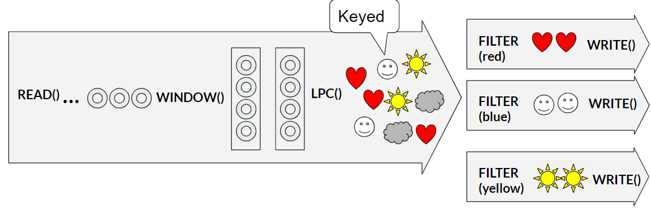
Backup things

